Slide 1
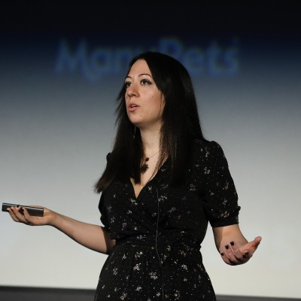



Do low-code projects need Change Management? Appsolutely!
Angeliki Patsiavou
angeliki-patsiavou
@a_patsiavou

Slide 2

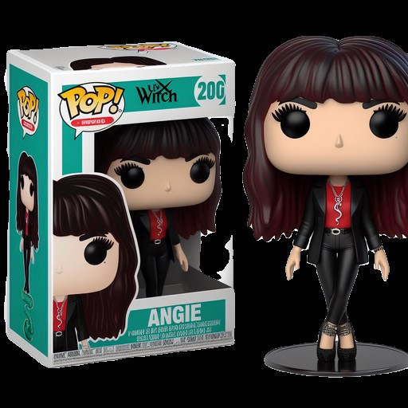













A bit about me
Angeliki Patsiavou
Human Evangelist
Speaker
Blogger
Hybrid
CRM Consultant
Change Manager
angeliki-patsiavou
@a_patsiavou

Slide 3







So, what’s going on?
The rise and fall of modern architecture
Highway to data
hell
Knocking on the citizen development door
Sweet adoption dreams are made of these
Crazy Change Management train
Rock you like a functionality hurricane
Bring me security to
life
Notes:
Use zero trust not zero compliance or security phrase

Slide 4


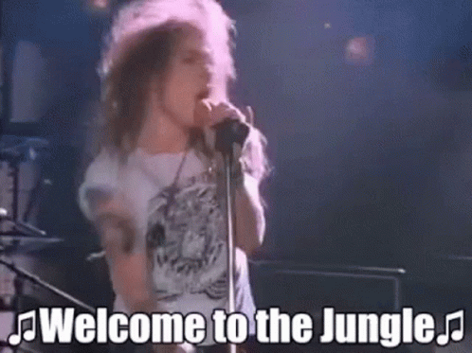

Brief history of computing
Connecting to masses
Scaling up enterprise
PC rise (Apple and MS),ALM foundations and more power in client-server era
Web to mobile era led from monolithic to rich applications, Agile & DevOps
1980s-90s
2000s-10s
Dreaming
big
Getting low
or no code
From WW2 Colossus and mainframe computing to new software discipline
Disrupting and democratizing IT to meet ask for end-user computing
1940s-80s
2010s-present
Notes:
Dreaming big: Talk about all these people in Bletchley Park as an example that needed to be employed post WW2, issue with women with marriage bar and Stephanie (Dame) Shirley who launched Freelance programmers to hire competent women with flexibility and to give opportunities. Finally sex discrimination act and equal pay act in 70s. Still most ran on mainframes, not even network
Connecting to masses: Mention opportunities opening up for programming, exploring new tech, but still need to discuss inequality in targeting women or also women able to study and follow tech careers. Starting to connect more to mass world needs and processes. Still a wilderness frontier though like when first programming for the Apollo spacecraft. Cheaper products and more feature richness in biz apps e.g. UI. Still limited separation on server side.
- Scaling up enterprise:
- Getting low or no code:
d

Slide 5

Through the looking glass
Gartner estimates that by 2026, 75% of new applications developed by enterprises will use low-code or no-code technologies, up from less than 25% in 2020.

Slide 6







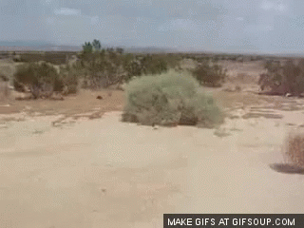



The evil that men do
IT Governance
Pro-dev
Governed fusion teams
Shadow citizen developers
Change Management

Slide 7
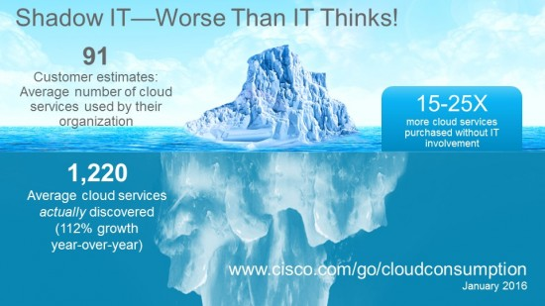
Mama, I just killed a man (made IT function)
Where was the business maturity assessment?
No leadership alignment or Change Champions?
Did no one communicate the licensing process?
And many more Change Management misses…

Slide 8




Highway to data hell
No Hygiene
Loss
Without Governance Framework or Change Management, it’s garbage in-garbage out
From cradle to grave with Change Management:
Data mapping, dictionaries & reporting
Theft
No oversight
CRUD permissions & configuration
Model changes, integrity & compliance
Inconsistency
+ Solid data strategy (and Loop) key for M365 Copilot!

Slide 9

The best way to contribute more is not to take up more airtime. It’s to increase your ratio of insight to airtime.
Adam Grant

Slide 10
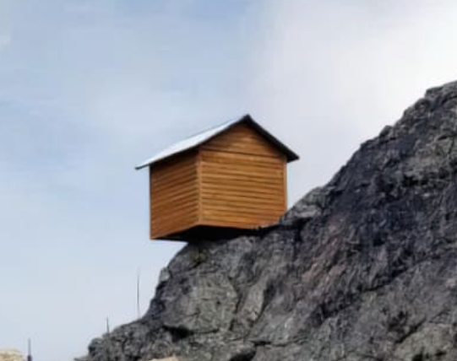



Rock you like a functionality hurricane
Without a Change Approval Board and defined ownership, it’s total architecture wilderness
From cradle to grave with Change Management:
Enterprise
Architecture
People VS system & process mapping
Prioritization & Change Champions
Business continuity & Comms
Notes:
Unknown downstream impact, integration challenges, feature preservation, automation failures

Slide 11



Knocking on the citizen development door
Without a relatable vision for reimagining IT or fusion teams, it’s like crossed wires
From cradle to grave with Change Management:
Fusion center of enablement
Operating model & custom OKRs
Copilot Lab and Power up together

Slide 12



Rulebooks
tell people what to do
Rulebooks
insist on discipline
Frameworks
guide people on how to act
Frameworks
allow for creativity
Simon Sinek

Slide 13




Bring me security to life
Without a joint cyber mission to avoid hidden costs, it’s like post-apocalyptic fiction
From cradle to grave with Change Management:
Roles, responsibilities & due diligence
Role-based training & XLAs
Due diligence goals & recognition

Slide 14

Sweet adoption dreams are made of these
Without a clear case for change or adoption, it’s a blind freefall jump
From cradle to grave with Change Management:
“So what?” benefits explained
User journeys co-designed
AI learning habits-Copilot Lab

Slide 15

Who you gonna call?
Innovation cannot be stopped but needs the right culture to thrive
Gartner research
Some facts
Workplace trends
x2.6 more likely to accelerate digital transformation
Over 150 Microsoft Copilot products, always increasing
70% of employees to delegate to AI, 87% of companies see a competitive edge
4/5 technologists in departments outside of IT
ChatGPT only took ~2 months to reach 100 million users
The next frontier of low-code is extensibility at all levels
Sources:
Why Do Business Technologists Matter? (Gartner)
Microsoft 2023 Work Trends Index, MIT Sloan Management Review

Slide 16
Smells like change spirit
Your to-do list is here to invest on your people
Low/no code to max ease, storytelling & productivity
Always listen for modern real-time service
Consumer value → loyalty & outcomes
Thriving and meaningful low/ no code ecosystem
Change Management enabled

Slide 17
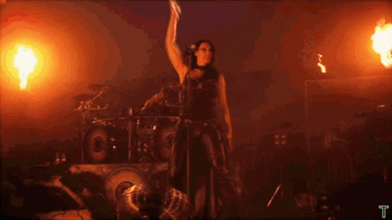
Fire up your questions

Slide 18
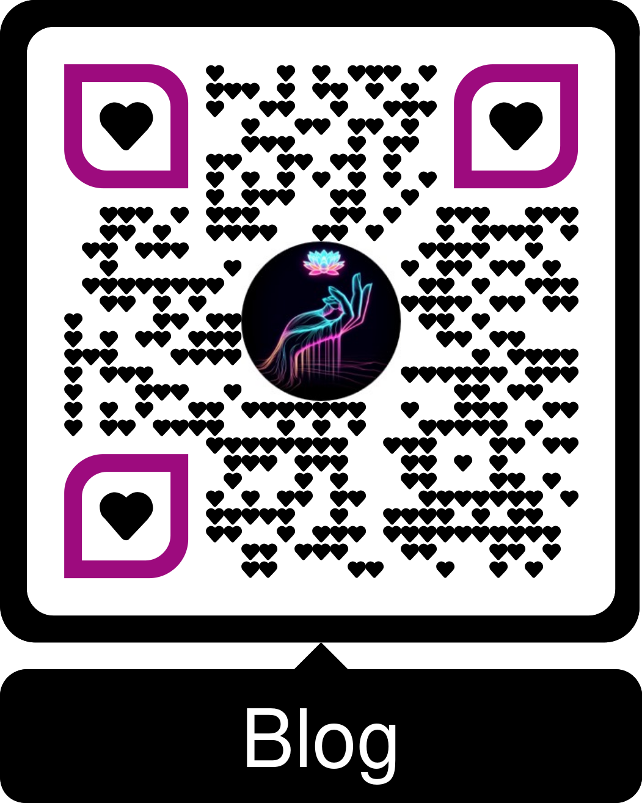

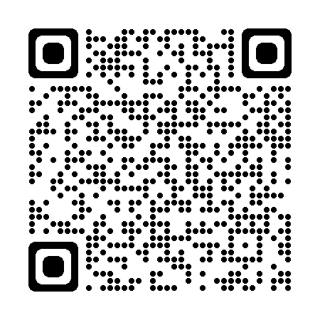
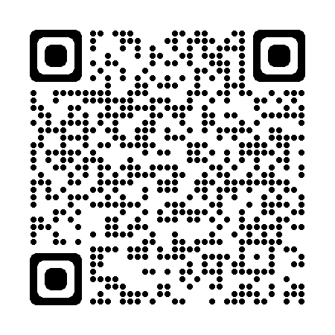
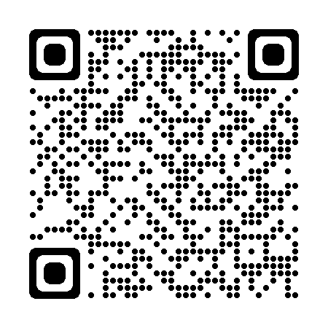
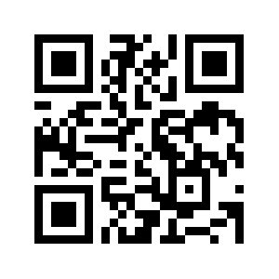
HAVE A GREAT DAY
Looking forward to connecting!
Blog
LinkedIn
Twitter
Session feedback
And keep on rocking!

